Slide 1
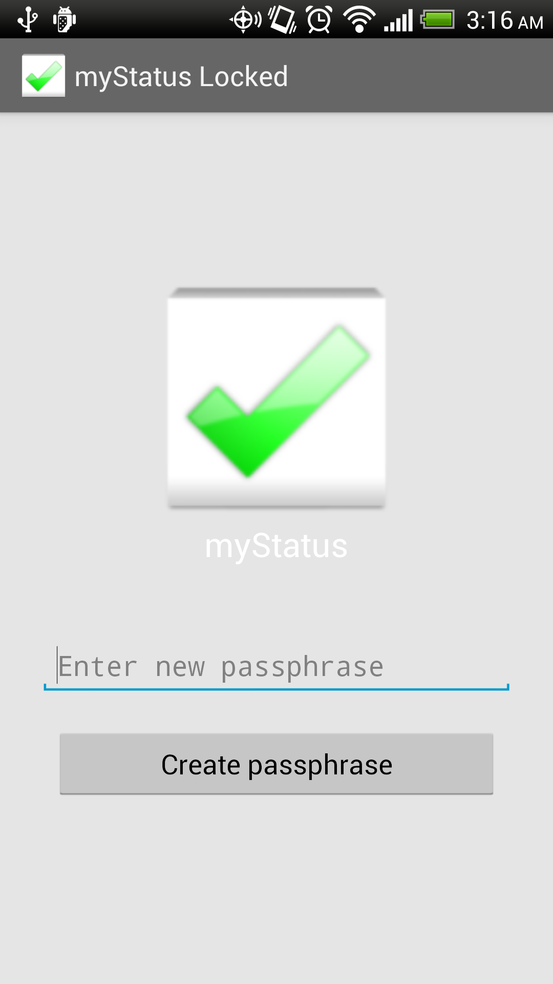
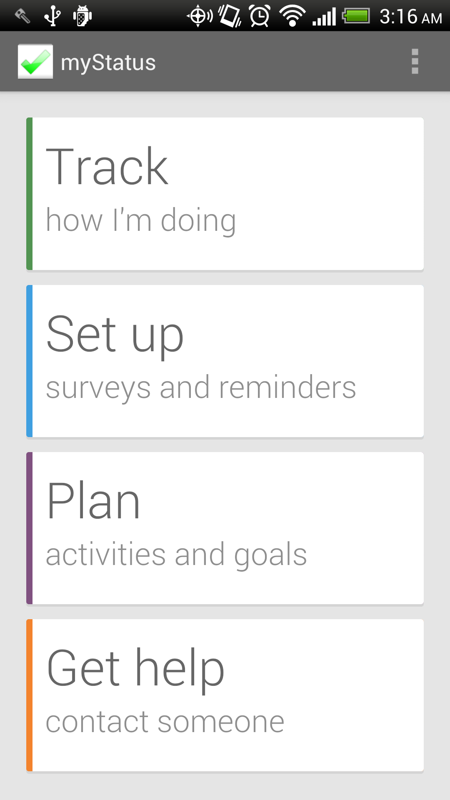
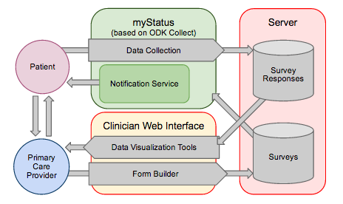
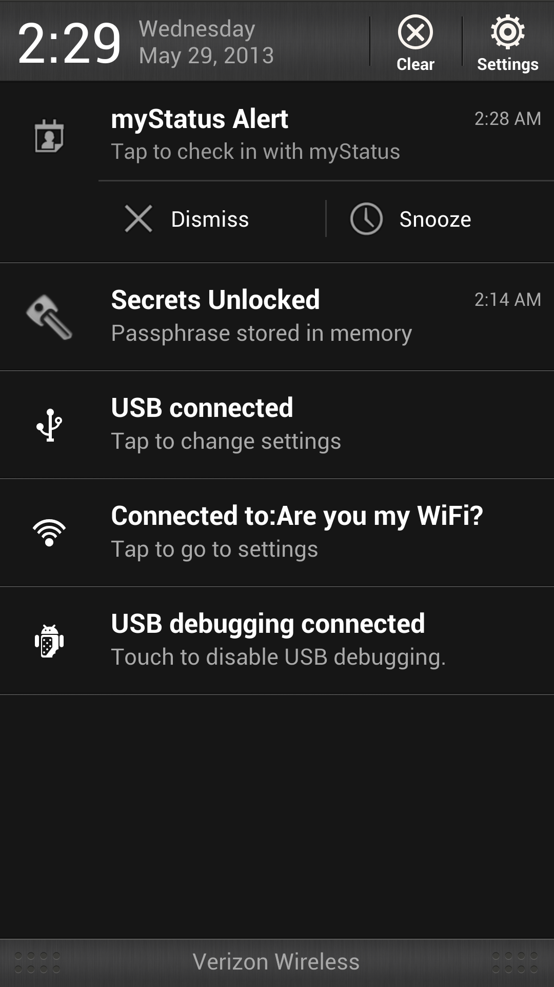
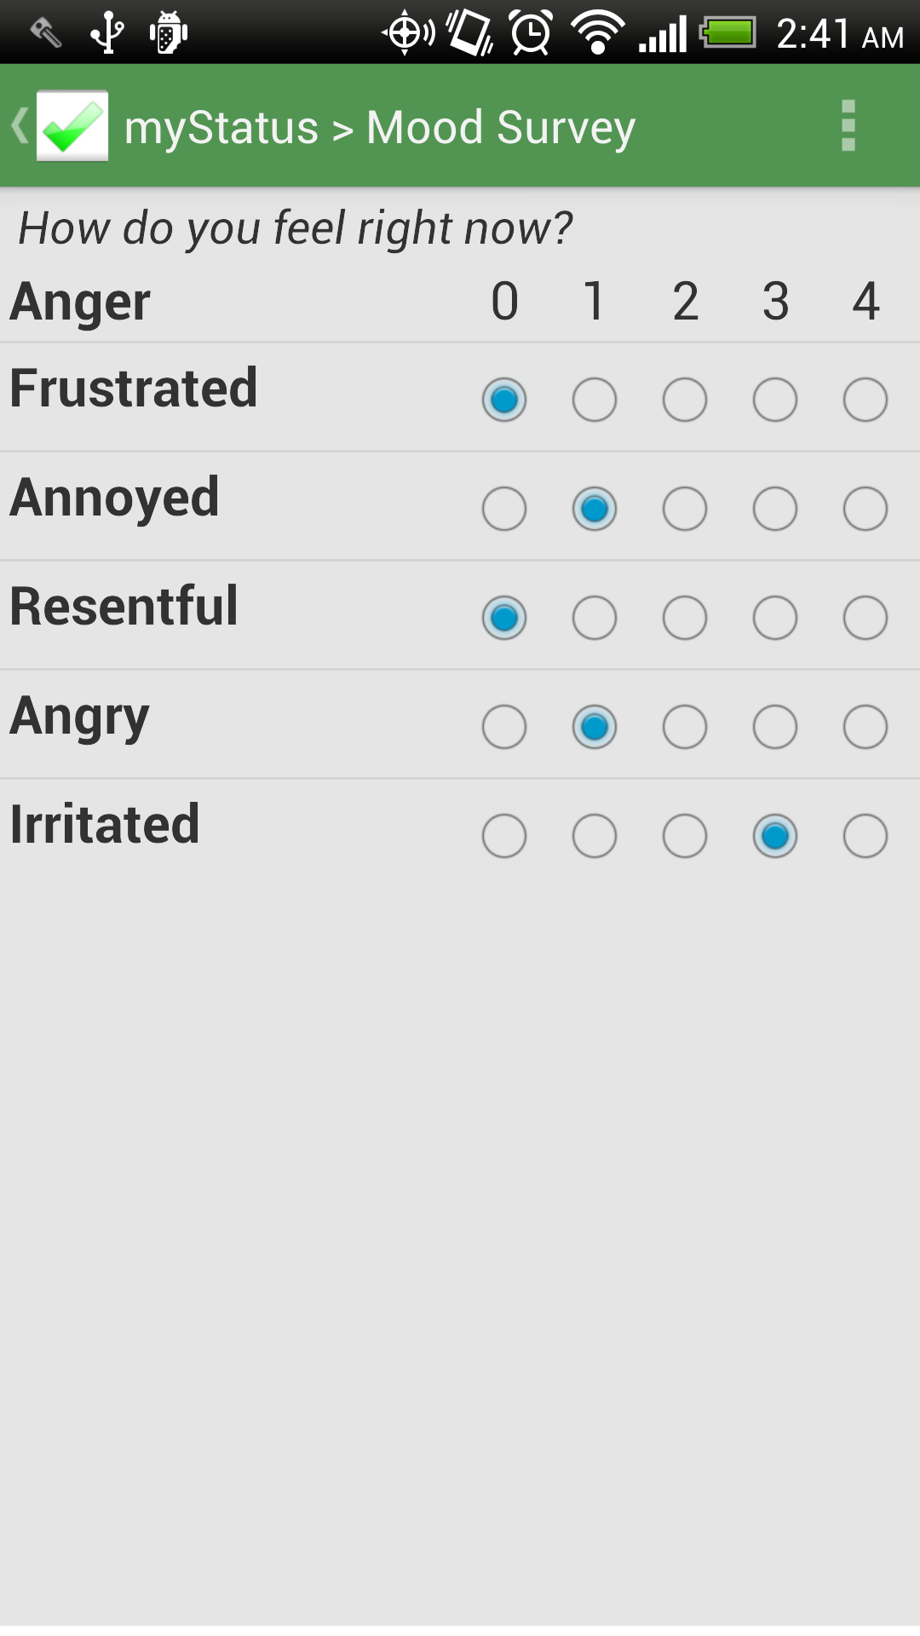
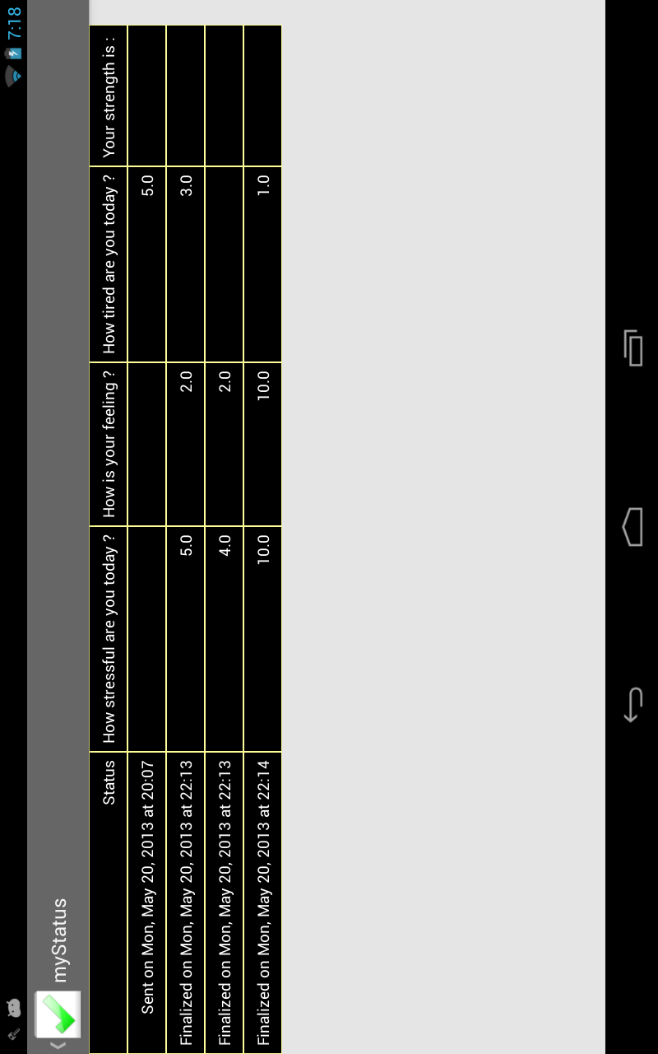
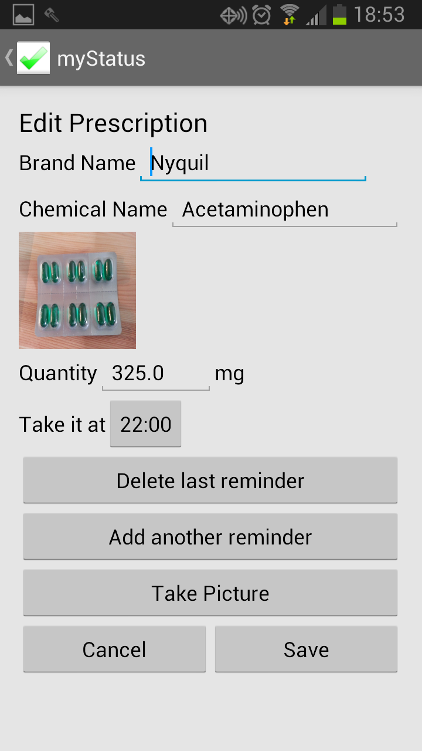
CSE490D-CSE481K/HCDE496 – 2011
Designing Technology for Resource-Constrained Environments
myStatus
Jake Bailey, Emily Chien, Chuong Dao
What's wrong with existing depression care?
Only 50% of patients referred to a mental health professional follow through with the referral.
Many do not have more than one visit.
50-70% of patients do not have a full response to the first treatment plan, need changes in treatment.
Proper depression care requires persistence, but the onus is placed on depressed patients to follow up and maintain care.
Left:
One time password creation.
System locks after five minutes of inactivity.
Right:
Main menu
Left:
myStatus Alert directs the user to surveys that need to be taken based on their Predicate.
Secrets Unlocked indicates data is currently unencrypted.
Right:
Example survey
Data visualization on History page (e.g. graphing)
Integration with RedCap (or other patient information systems)
Submitting data
Visualizing collected data
Building forms and distributing them to patients
Educational pages tailored to patient demographic and subscribed surveys
Automatically downloading updated surveys
Allow clinicians to set patients' survey subscriptions
Allow patients to ask clinicians questions through the app
Above:
History page displays responses from past surveys taken.
Left:
Prescription setup allows users to add reminders for when to take their pill.
http://www.cs.washington.edu/education/courses/cse490d/11sp/
Notes:
*

